Slide 1
Skills Bootcamp Classroom Rules
Be on time: Just like in a physical classroom, it's important to be punctual for your online class. Log in to the virtual classroom a few minutes before the class starts.
Turn Cameras on: In order to maximise your learning studies show that being able to see your peers and your tutor being able to see you can increase motivations and retention, therefore we ask to keep your cameras on.
Attend all classes: In order to be successful in your bootcamp studies you need to attend all live sessions, therefore you should prioritise and make time for these sessions.
Avoid distractions: Turn off your phone notifications, close any other unnecessary tabs, and focus solely on the class.
Participate actively: It's important to be an active participant in the class. Ask questions, answer questions, and participate in discussions.
Use proper language and tone: Use respectful language and tone when communicating with your classmates and instructor. Avoid using slang or inappropriate language.
Respect others' opinions: Be respectful of others' opinions, even if they differ from your own. Avoid making negative comments or attacking others.
Follow the instructor's guidelines: Follow the instructor's guidelines, such as submitting assignments on time.
Be polite: Be polite and respectful to everyone in the class, including the instructor, classmates, and guest speakers.
Dress appropriately: Even though you are not in a physical classroom, it's important to dress appropriately. Dress as if you were going to a face-to-face class.
Use appropriate technology: Ensure that you have the necessary equipment, such as a reliable internet connection, a microphone, and a webcam, and that they are in good working condition.

Slide 2
Software Developer Bootcamp
Unit 2 – Digital Processes and Services
Week 6B

Slide 3
Objectives
Following this session, you should be able to:
Understand the Role of Databases in Software Applications
Identify Key Benefits of Database Integration
Evaluate Database-Software Application Linking Mechanisms
Understand variable initialisation.

Slide 4
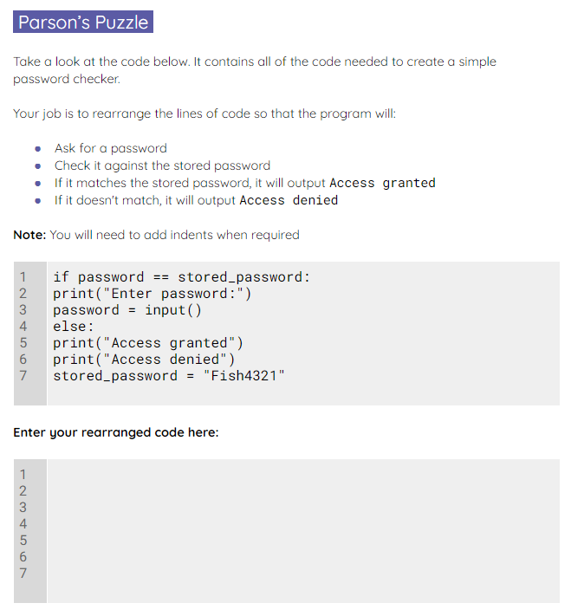
Parson’s Puzzle
Use the starter activity worksheet to solve the Parson’s Puzzle.
Notes:
A0 Worksheet – Parson_s puzzle

Slide 5
Answer
Variable initialisation and assignment should execute at the top of the code where possible.
1
2
3
4
5
6
7
stored_password = "Fish4321"
print("Enter password:")
password = input()
if password == stored_password:
print("Access granted")
else:
print("Access denied")

Slide 6
Answer
The user will then need a prompt to enter a password before they enter it.
The user input will need to be held in another variable.
1
2
3
4
5
6
7
stored_password = "Fish4321"
print("Enter password:")
password = input()
if password == stored_password:
print("Access granted")
else:
print("Access denied")

Slide 7
Answer
An if statement is then used to check if the stored password matches the entered password.
If the condition is True, then it will output “Access granted”.
1
2
3
4
5
6
7
stored_password = "Fish4321"
print("Enter password:")
password = input()
if password == stored_password:
print("Access granted")
else:
print("Access denied")

Slide 8
Answer
If the condition is False, then it will output “Access denied”.
1
2
3
4
5
6
7
stored_password = "Fish4321"
print("Enter password:")
password = input()
if password == stored_password:
print("Access granted")
else:
print("Access denied")

Slide 9

Playing cards: True or false?
You will now be given a playing card.
You will need to know the following properties of the card:
Colour (black or red)
Suit (hearts, clubs, diamonds, or spades)
The value (number, or jack, queen, king, ace, joker)
Ace is low (value = 1)

Slide 10
Playing cards: True or false?
You will now be shown expressions.
You have to decide if your card evaluates as True or False.
Stand in the appropriate place in the room, depending on how you have evaluated (True or False).

Slide 11
True or false?
value > 6
1
2
3
4
5
6
7
value = int(input())
if value > 6:
print("My card is a match")
else:
print("My card is not a match")

Slide 12
True or false?
value == “king”
and
suit == “hearts”
1
2
3
4
5
6
7
value = input()
suit = input()
if value == "king" and suit == "hearts":
print("My card is a match")
else:
print("My card is not a match")

Slide 13
True or false?
suit == “spades”
and
suit == “hearts”
1
2
3
4
5
6
7
suit = input()
if suit == "spades" and suit == "hearts":
print("My card is a match")
else:
print("My card is not a match")
Notes:
Warning: This is meant to throw your learners a little as it is impossible for the condition to be True.

Slide 14
True or false?
suit != “hearts”
1
2
3
4
5
6
7
suit = input()
if suit != "hearts":
print("My card is a match")
else:
print("My card is not a match")

Slide 15
True or false?
colour != “red”
and
suit == “hearts”
1
2
3
4
5
6
7
colour = input()
suit = input()
if colour != "red" and suit == "hearts":
print("My card is a match")
else:
print("My card is not a match")

Slide 16
True or false?
value < 7
or
suit == “spades”
1
2
3
4
5
6
7
value = int(input())
suit = input()
if value < 7 or suit == "spades":
print("My card is a match")
else:
print("My card is not a match")

Slide 17
The Role of Databases in Software Applications

Slide 18

What is a Database?
- Definition of a Database: A database is a structured data collection that can be easily accessed, managed, and updated.
- Types of Databases: Databases can be categorised into various types such as relational, NoSQL, in-memory, and graph databases, each with its own specific use cases and advantages.
- Examples of Databases: Some commonly used databases are MySQL, MongoDB, PostgreSQL, and SQLite, catering to different needs ranging from web applications to big data analytics.

Slide 19

The Benefits of Databases
- Data Storage and Retrieval: Efficient data storage and retrieval are foundational for maintaining an agile and responsive software application, enabling real-time access to information when needed.
- Data Security and Integrity: Ensuring data security and integrity is critical for safeguarding sensitive information and maintaining trust with users while also complying with regulations.
- Data Sharing and Collaboration: Seamless data sharing and collaboration functionalities can significantly enhance team productivity, facilitate cross-departmental communication, and expedite decision-making processes.

Slide 20

Database Design
- Database Normalisation: Database normalisation is the process of organising data within a database to reduce redundancy and improve data integrity.
- Database Modelling: Database modelling involves defining the structure and relationships between data sets to facilitate efficient data storage, retrieval, and management.
- Database Optimisation: Database optimisation focuses on enhancing the performance of a database system by fine-tuning queries, indexing, and other configurations to improve speed and resource use.

Slide 21
Database Management Systems
- Relational Database Management Systems (RDBMS): An RDBMS uses tables to store data and enables complex queries and transactions, excelling in ACID compliance for data integrity and consistency.
- Object-oriented Database Management Systems (ODBMS): An ODBMS allows for storing and manipulating data as objects, providing a more natural mapping to object-oriented programming languages.
- NoSQL Database Management Systems (NDBMS): An NDBMS offers a flexible schema for unstructured or semi-structured data, often providing scalability advantages for large datasets and real-time applications.

Slide 22
Database Queries
- Structured Query Language (SQL): SQL is a domain-specific language used for managing and manipulating relational databases, facilitating tasks such as data retrieval, insertion, and updating.
- Object-oriented Query Language (OQL): OQL is a query language specifically designed for querying object-oriented databases, enabling more complex data retrieval methods that align with object-oriented paradigms.
- NoSQL Query Language (NQL): NQL is a flexible query language used in NoSQL databases, designed to accommodate a variety of data models, including key-value, document, wide-column, and graph databases.

Slide 23

Database Security
1. Authentication and authorization: While authentication verifies a user's identity, authorization determines what actions they can perform.
2. Encryption and decryption: Encryption transforms data into a coded format for security, while decryption converts it back to its original form for readability.
3. Auditing and logging: Auditing evaluates the adherence to specific standards or policies while logging captures a record of system or application activities.

Slide 24

Conclusion
Databases are the foundation of software applications
Database design, management, queries, security, performance, and integration are essential components of software applications
Databases are the key to unlocking the power of data

Slide 25
Key Benefits of Database Integration

Slide 26

Data Accessibility
Database integration allows for easy access to data from multiple sources.
Data can be accessed quickly and efficiently.
Data can be accessed from anywhere with an internet connection.

Slide 27

Data Security
Database integration provides a secure environment for data storage and retrieval.
Data is encrypted and stored in a secure environment.
Data is protected from unauthorized access and manipulation.

Slide 28

Data Quality
Database integration ensures data accuracy and consistency.
Data is validated and checked for accuracy.
Data is standardized and formatted for easy retrieval and analysis.

Slide 29

Data Analysis
Database integration enables data analysis and reporting.
Data can be analyzed to identify trends and patterns.
Data can be used to generate reports and insights.

Slide 30

Data Sharing
Database integration allows for data sharing across multiple platforms.
Data can be shared with other users and systems.
Data can be shared securely and efficiently.

Slide 31

Data Automation
Database integration enables data automation.
Data can be automatically updated and synchronized.
Data can be automatically processed and analyzed.

Slide 32

Data Visualisation
Database integration enables data visualization.
Data can be visualized in charts, graphs, and maps.
Data can be used to create interactive dashboards and reports.

Slide 33

Data Scalability
Database integration allows for data scalability.
Data can be easily scaled up or down as needed.
Data can be stored and accessed from multiple locations.

Slide 34

Conclusion
Database integration provides many benefits for businesses.
Data can be accessed, secured, analyzed, and shared.
Data can be automated, visualized, and scaled.
Database integration unlocks the power of data.

Slide 35
Evaluate Database-Software Application Linking Mechanisms

Slide 36
What is Database-Software Application Linking?
- Definition of Database-Software Application Linking: Database-software application linking refers to the methods and techniques used to connect and enable data exchange between a database and a software application.
- Types of Database-Software Application Linking: The most common types of database-software application linking include API (Application Programming Interface) connections, ORM (Object-Relational Mapping), and direct database connections via SQL queries.
- Benefits of Database-Software Application Linking: The benefits of effective database-software application linking include enhanced data security, real-time data access, improved system scalability, and streamlined business operations.

Slide 37
Advantages of Database-Software Application Linking
Increased Efficiency
Reduced Costs
Improved Data Quality
Enhanced Security

Slide 38
Disadvantages of Database-Software Application Linking
Increased Complexity
Increased Risk of Data Loss
Increased Risk of Security Breaches
Increased Maintenance Costs

Slide 39

Database-Software Application Linking Tools
SQL Server Integration Services (SSIS)
Oracle Data Integrator (ODI)
Informatica PowerCenter
Talend Open Studio

Slide 40

Database-Software Application Linking Best Practices
Develop a Comprehensive Plan
Test and Validate Data
Monitor Performance
Secure Data

Slide 41
Database-Software Application Linking Challenges
Data Formatting
Data Quality
Data Security
Data Integration
Notes:
- Data Formatting: Data formatting involves structuring or converting data into a specific layout or form to facilitate its accurate and efficient processing.
- Data Quality: Data quality refers to the level of accuracy, completeness, consistency, and reliability of data collected and stored in a database.
- Data Security: Data security encompasses measures and protocols in place to protect data from unauthorized access, alterations, or theft.
- Data Integration: Data integration is the process of combining data from various disparate sources into a single, unified view to improve decision-making and operational efficiency.

Slide 42

Database-Software Application Linking Solutions
Data Quality Tools
Data Security Tools
Data Integration Tools
Data Visualization Tools
Notes:
- Data Quality Tools: These tools assist in cleansing, validating, and enriching raw data, ensuring it is accurate, consistent, and actionable for business intelligence.
- Data Security Tools: These software solutions focus on safeguarding an organisation's data from unauthorised access, corruption, or theft, ensuring compliance with regulations like GDPR.
- Data Integration Tools: These platforms facilitate the seamless consolidation of data from multiple sources into a unified view, enabling more effective decision-making.
- Data Visualisation Tools: These tools convert complex data sets into graphical representations like charts or graphs, making it easier for stakeholders to understand and interpret data trends and insights.

Slide 43
Database-Software Application Linking Trends
Cloud Computing
Data Analytics
Data Governance
Data Virtualisation
Notes:
- Cloud Computing: Cloud computing allows businesses and individuals to store, manage, and process data on remote servers hosted on the internet, rather than on local servers or personal computers.
- Data Analytics: Data analytics involves the use of specialised software and algorithms to examine large data sets to identify patterns, trends, and insights that can aid in decision-making.
- Data Governance: Data governance refers to the set of practices and guidelines that ensure high data quality and reliable data management within an organisation.
- Data Virtualisation: Data virtualisation is the process of aggregating data from different sources through a single virtual view, making it easier to manage and access without requiring physical storage.

Slide 44

Conclusion
Understand the Benefits and Challenges
Choose the Right Tools and Solutions
Stay Up-to-Date on Trends
Make an Informed Decision

Slide 45
Objectives
Now, you should be able to:
Understand the Role of Databases in Software Applications
Identify Key Benefits of Database Integration
Evaluate Database-Software Application Linking Mechanisms

Slide 46

Questions?

Slide 47
Thank You

